Slide 1

TIC TAC TOE GAME
By-
Pritish Samant
Syed Muhammad Abis Rizvi
Md Limon Apu

Slide 2
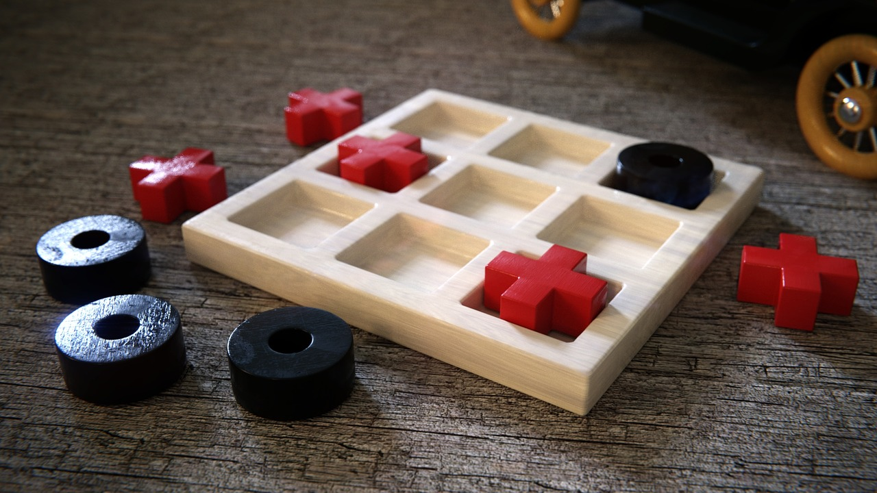
What is Tic Tac Toe game?
Tic Tac Toe is a two-player, 3x3 grid, paper and pencil game.
The winner is decided by the person who makes his or her first three marks in a diagonal, vertical, or horizontal row.
Image by Lars Plöger from Pixabay

Slide 3
FPGA AND VHDL
FPGAs are ideal for prototyping ASICs and processors.
FPGAs are used by Intel to prototype new chips.
VHDL enables complicated electronic circuit behavior to be captured in a design system for automatic circuit synthesis or system simulation.

Slide 4
Application of our prototype
Tic Tac Toe is a game that supports one player and two player game.
You can play against another human or against your mobile phone.
The AI (Artificial Intelligence) for one player mode includes different difficulty levels.
You can play against a computer player that matches your skill level.
Main application of our prototype is Tic Tac Toe game.

Slide 5
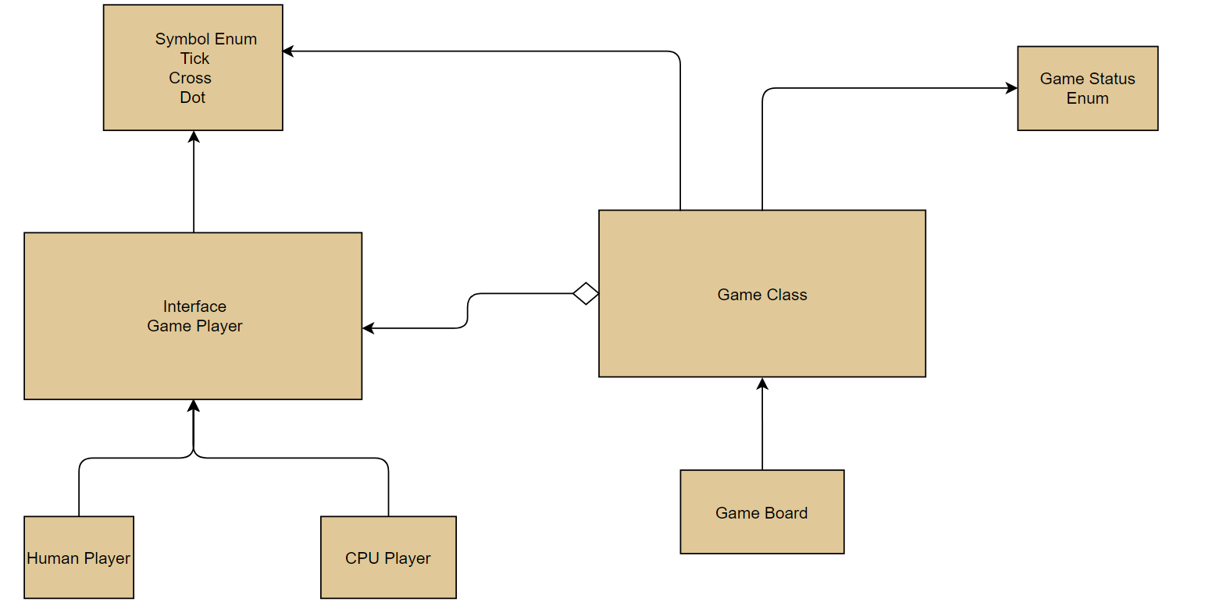
Block Diagram

Slide 6
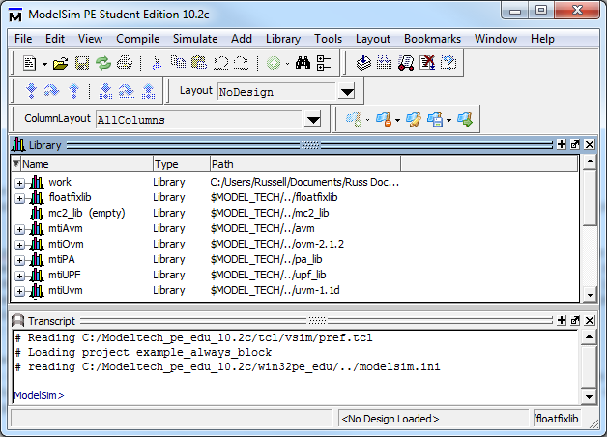
Technologies used
ModelSim
ModelSim is a verification and simulation tool for VHDL, Verilog, SystemVerilog, and mixed- language designs.
https://nandland.com/introduction-to-modelsim-for-beginners/

Slide 7
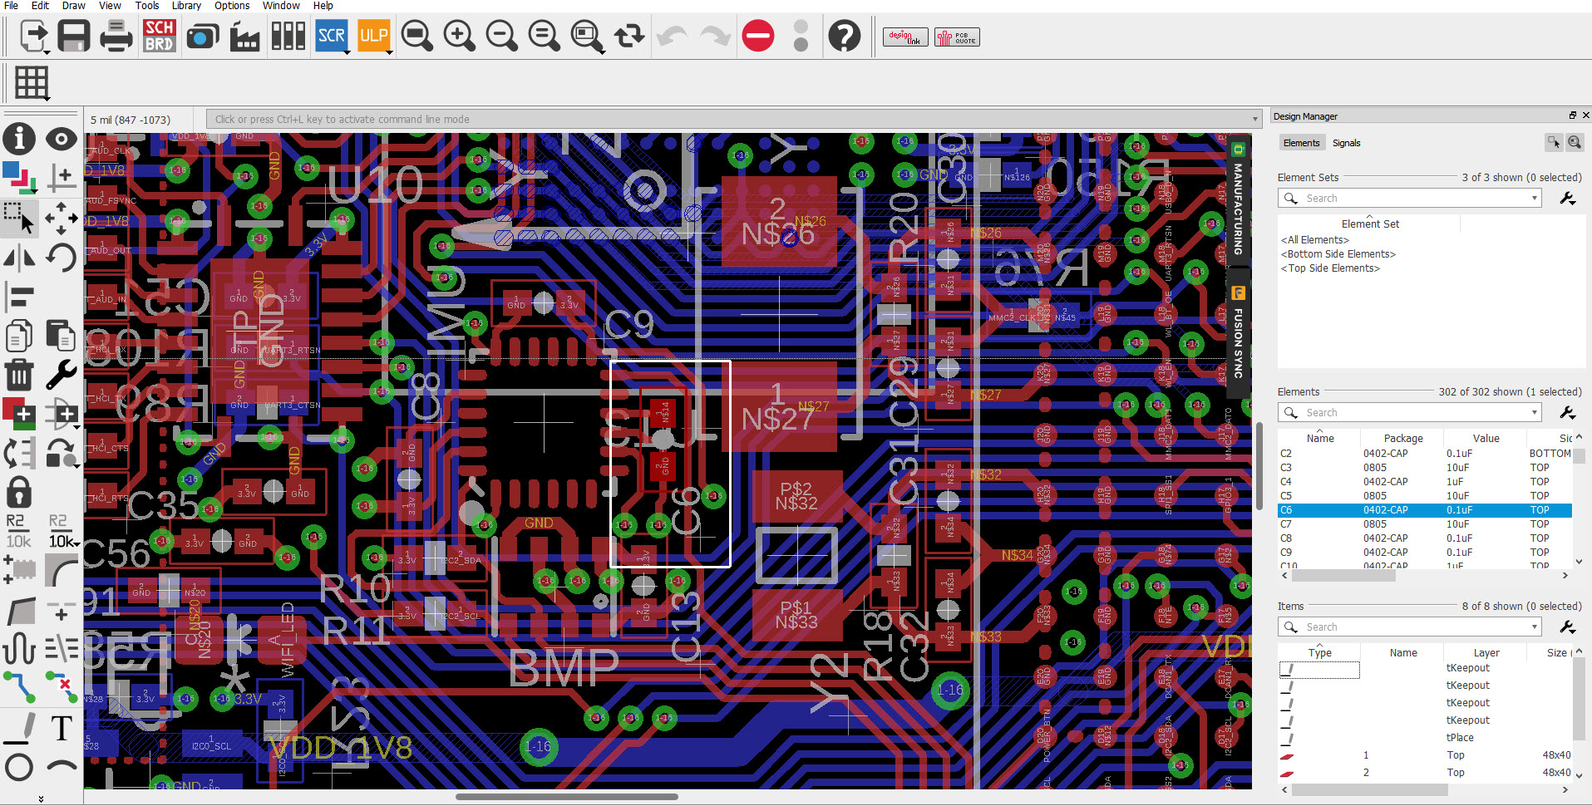
Technologies used
Eagle
Printed circuit board (PCB) designers may easily connect schematic designs, component placement, PCB routing, and extensive library content using the electronic design automation (EDA) tool EAGLE.
https://www.autodesk.com/products/eagle/blog/autodesk-eagle-9/

Slide 8
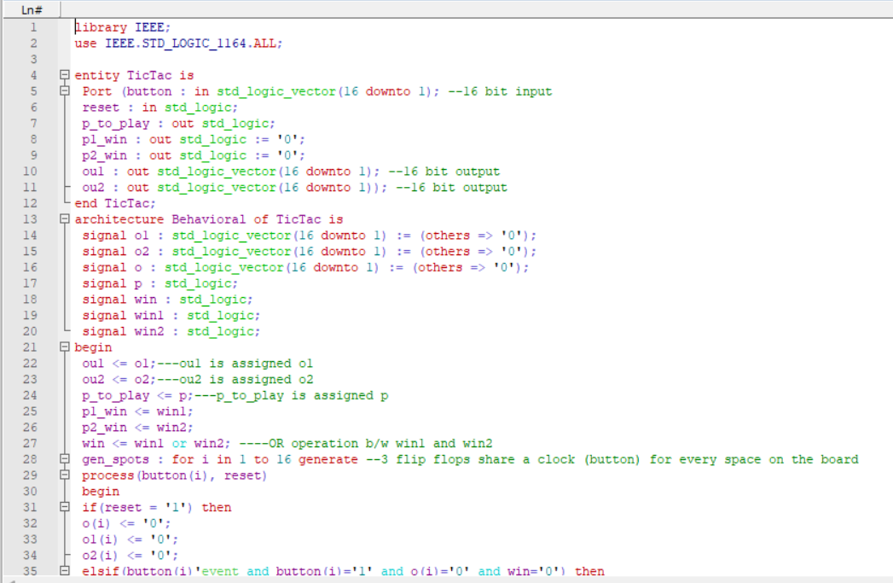
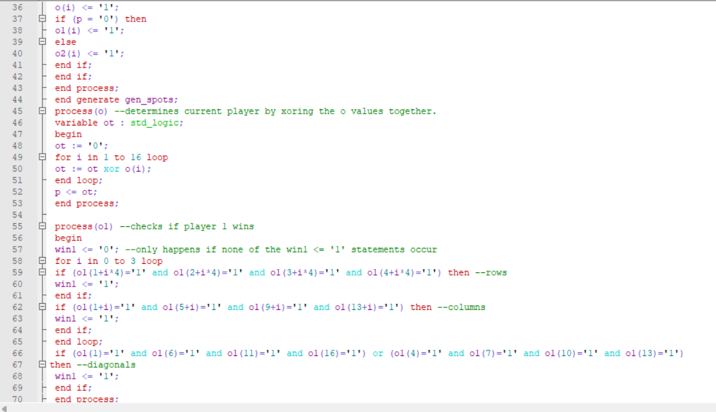
VHDL code

Slide 9
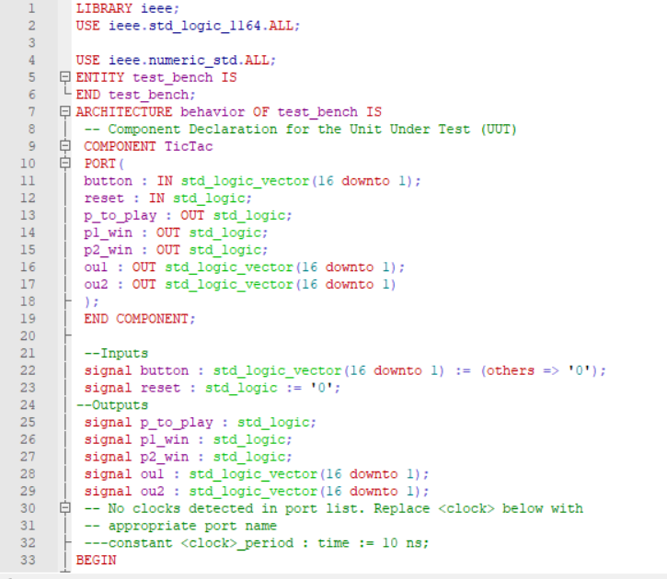
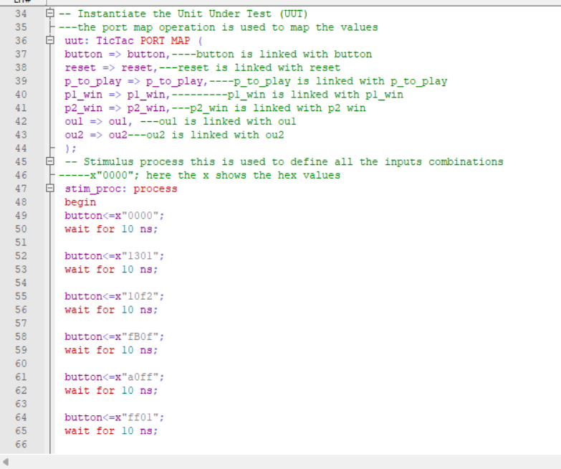
VHDL testbench

Slide 10
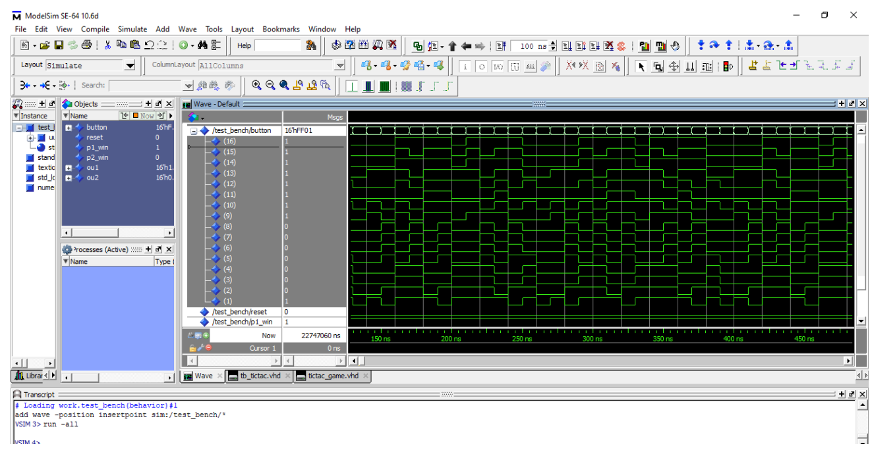
VHDL Simulation

Slide 11
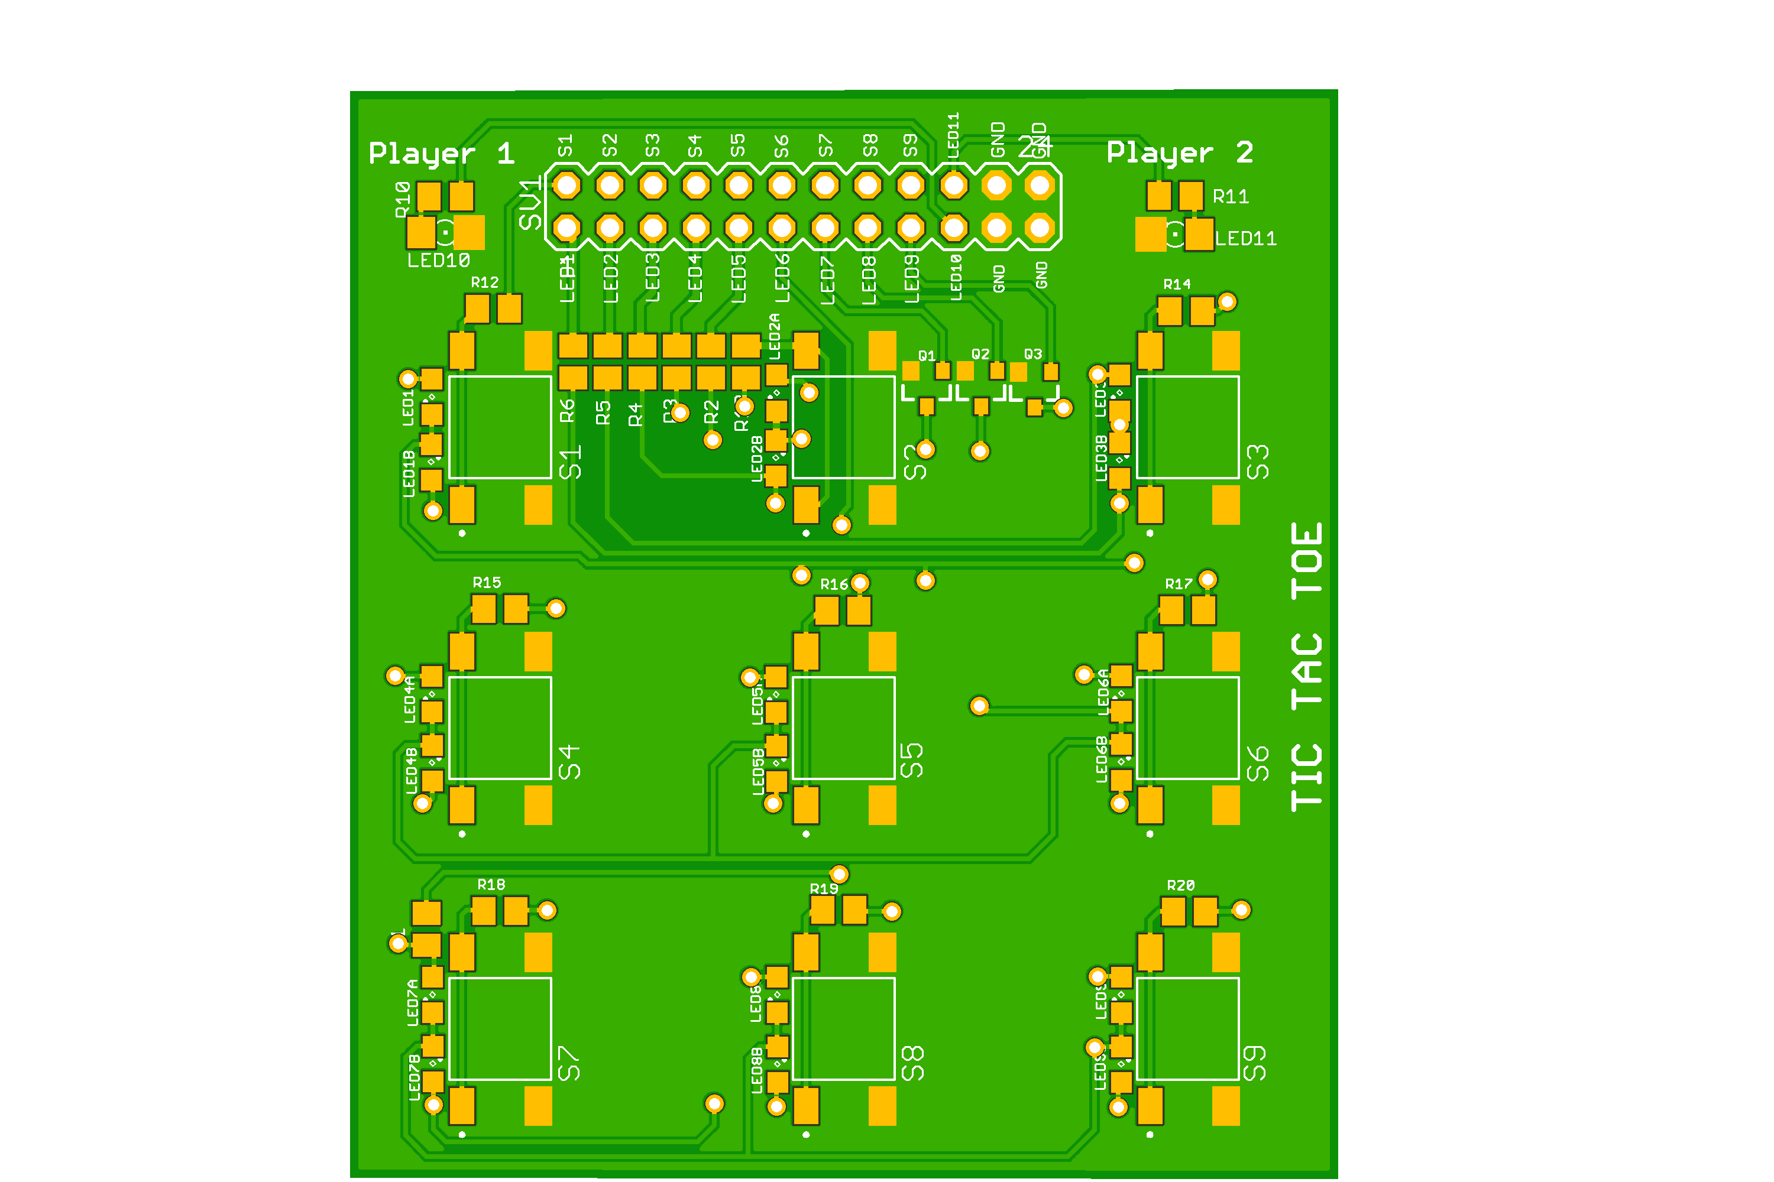
PCB Design

Slide 12
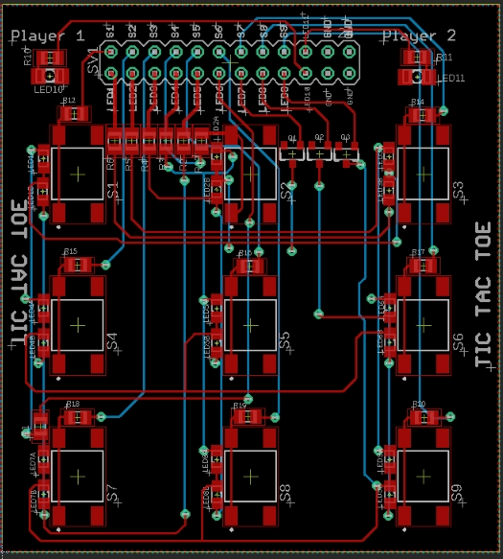
Schematics

Slide 13
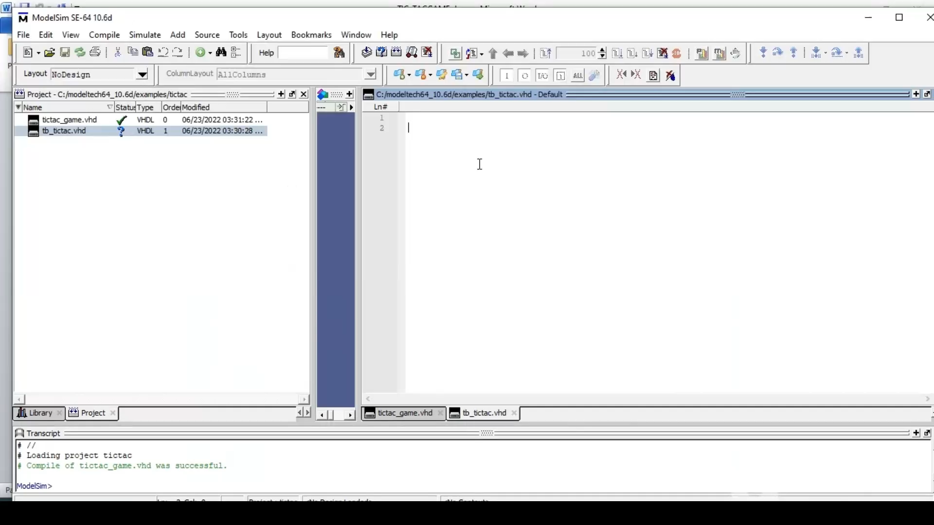
Simulation video

Slide 14
Conclusion
All age groups are most accustomed to playing Tic Tac Toe.
Any person who makes decisions for a specific reason can possess intelligence.
This fundamental notion has been advanced frequently.
A tested and described algorithm for playing tic tac toe operates effectively.
Overall, there are no bugs in the system.

Slide 15

Thank you!!!

